Slide 1
Python Stock Tracking Project
By Zijun Chai

Slide 2
Introduction
1.The project will create a stock tracking applications in Python using google Colab with object-oriented techniques.
2.The application will have both console and Graphical User Interfaces.
3.The application can generate profit/loss reports by processing the historical stock data.
4.The application will use the Python libraries to create charts and get historical stock data from web sites.
5.Link https://github.com/MarkCZJ/Python-Stock-Tracking-Project

Slide 3
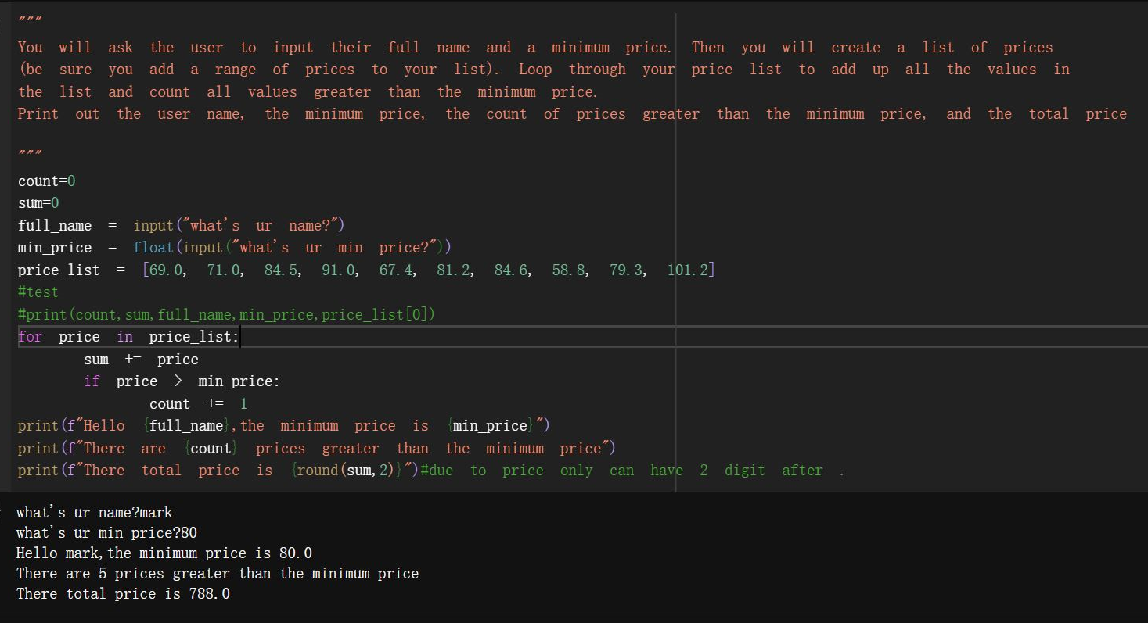
Module 1 Brief
Obj: Chose an IDE for the Project and Create a python program
Exp: Setting up the environment and review python programming

Slide 4
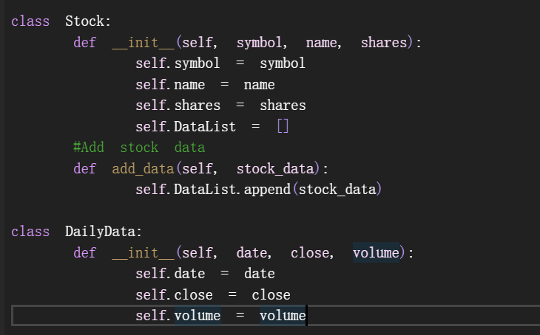
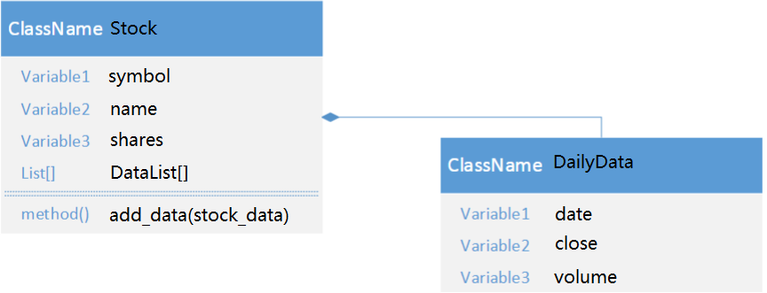
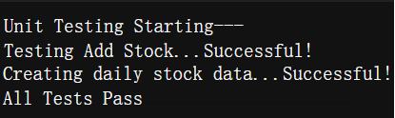
Module 2 Brief
Obj: Create Class Diagrams and Classes, then run unit test. Create a stock_class.py file.Add your name and date in the comments area.Write the code for your Stock class & DailyData class.
Exp: Developers use unit testing to test the code they write

Slide 5
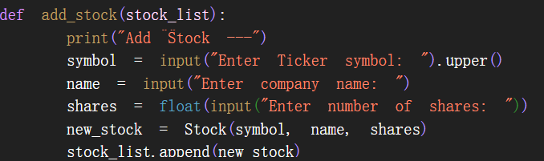
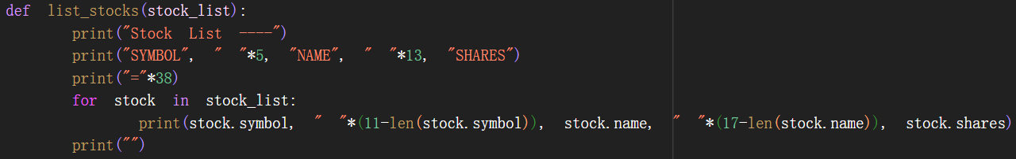
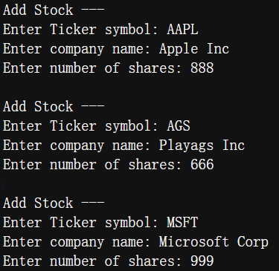
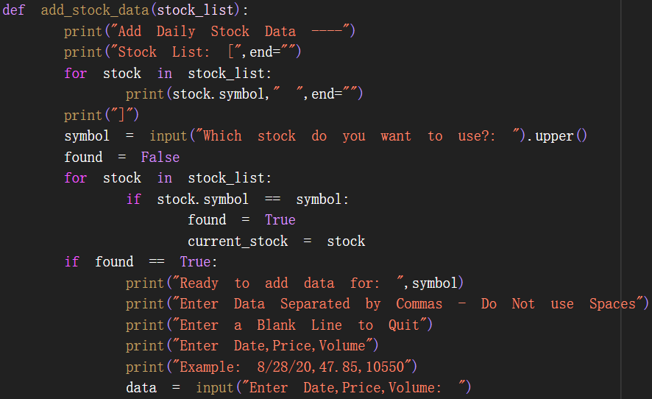
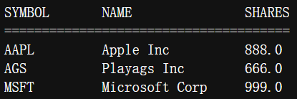
Module 3 Brief
Obj: Create a Menu-Driven User Interface to Add/List/Delete Stocks, and to Track Price and Volume History Create Functions to handle menu items.
Exp: Develop skills in creating user-friendly console and graphical interfaces, enhancing your capabilities in software design and user experience

Slide 6
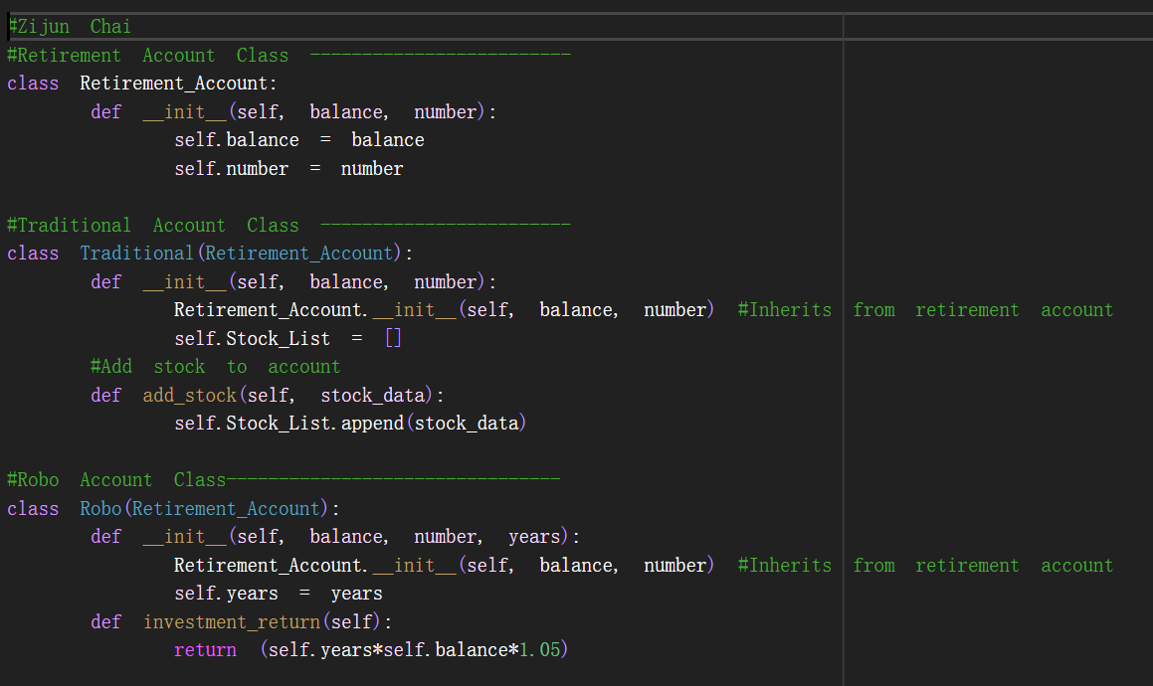
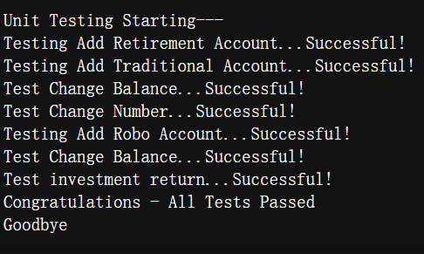
Module 4 Brief
Obj: implement inheritance in the stock program and Create three classes; then run unit tests
Exp:Understand the essence of inheritance in object-oriented programming by combining practical examples in the project.

Slide 7
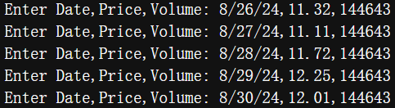
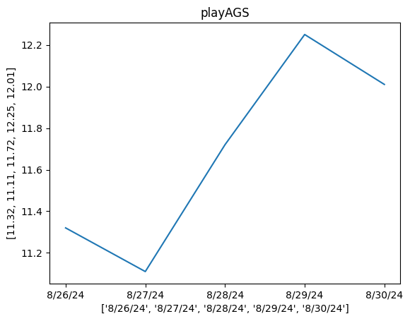
Module 5 Brief
Obj: Use the pyplot class in the matplotlib library to create a simple stock chart.
Exp: Because I often used Python as a tool for data mining and machine learning in the past, I am quite familiar with data visualization. This time is mainly works as a review.

Slide 8
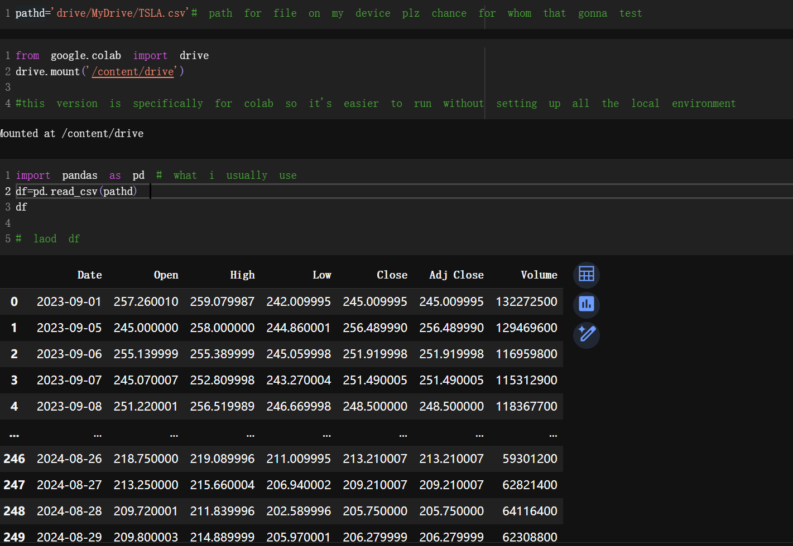
Module 6
Brief
Obj: Use the csv library to import data from Yahoo! Finance and Read data from a file.
Exp: Because I often used Python as a tool for data mining and machine learning in the past, I am quite familiar with data visualization. This time is mainly works as a review.

Slide 9
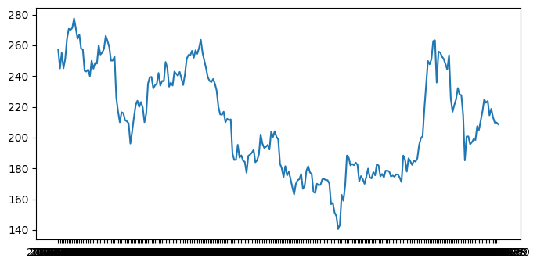
Module 7 Brief
Obj: Use tkinter to implement a graphical user interface
Exp: Because in the past, my direction was mainly in data analysis and algorithms. So this module is a good learning chance and challenge for me, making me more comprehensive and closer to full-stack development.

Slide 10
Career Skills Developed
1.Programming and Software Development: Enhance my coding skills in Python, one of the most popular programming languages. This project helped me master object-oriented programming (OOP) principles such as classes, inheritance, and polymorphism, which are fundamental for designing robust and scalable software.
2.User Interface Design: Develop my skills in creating user-friendly console and graphical interfaces, enhancing my capabilities in software design and user experience.
3.Problem Solving and Critical Thinking: Enhance my ability to solve complex problems and make decisions based on the analysis of data, a valuable skill in any technical or analytical role.
4.Software Testing and Debugging: Learn to test and debug my application, ensuring reliability and performance, which are critical aspects of software quality assurance.

Slide 11
Conclusion
Throughout the semester, building a stock tracking application in Python using object-oriented techniques and developing both console and graphical user interfaces have allow myself to develop and refine a variety of valuable career skills. For example: Programming and Software Development; User Interface Design; Problem Solving and Critical Thinking; Software Testing and Debugging; Documentation habit etc.

Slide 12
Thank you!

